Slide 1
Through Love, we go Beyond. 1 Corinthians (12-13)
Class 4
Information & Curriculum Meeting
September 2022
Notes:
1

Slide 2
Class Information
Class routines
Buddies
Behaviour management
Curriculum Information
Supporting your child at home

Slide 3
Who’s in class?
Ms Moore: Class Teacher, Monday am, Tuesday-Friday
Mrs Lognonne: TA, Mon-Fri
Mrs Finney: HLTA, Tuesday afternoon

Slide 4
Class Routines
Monday
New reading books given out.
Wednesday
PE with NUFC
Thursday
Music with Mrs Shevlin (recorders)
Friday
Spelling and tables review.

Slide 5
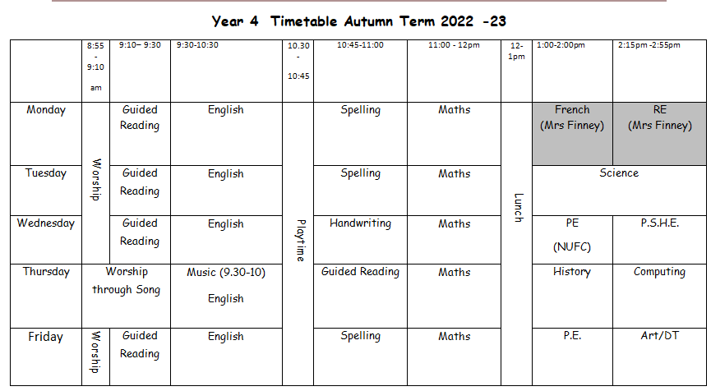

Slide 6
Buddies
Buddies support the younger children in school at break and lunchtime.
This role is designed to promote independence and help to prepare for greater responsibility in Year 5.

Slide 7
Behaviour Management
Being the best we can be
Perseverance
Co-operation
House points
Considerate
Resilience
Kindness
Hard work
School values

Slide 8
What does it mean to be in Year 4?
In Year 4 we want everyone to feel happy, safe and be able to learn. To make sure this happens we must:
1. Be an active listener.
2. Be independent and help one another.
3. Be kind and caring and a good friend.
4. Follow instructions.
5. Concentrate and always try our best.
6. Try not to distract others or shout out.
7. Keep the classroom tidy.
8. Look after school equipment and other people's belongings.
9. Be a good role model and always polite.
10. Be positive and have fun!

Slide 9
Sanctions

Slide 10
Communication
Messages:
Diaries are checked daily – please write in here for any changes of pick-up etc. (alternatively, contact us by phone or email.)
Appointments can be made to speak at length – drop off and pick up times are brief.
Electronically:
Class page on the school website
Twitter

Slide 11
Curriculum
Information can be found on our class page:

Slide 12
Maths
CPA approach – Low threshold, high ceiling tasks
High level maths vocabulary expectations
Quick facts recall – timetables ( Year 4 Statutory Tables Test June) number bonds, number recognition.

Slide 13
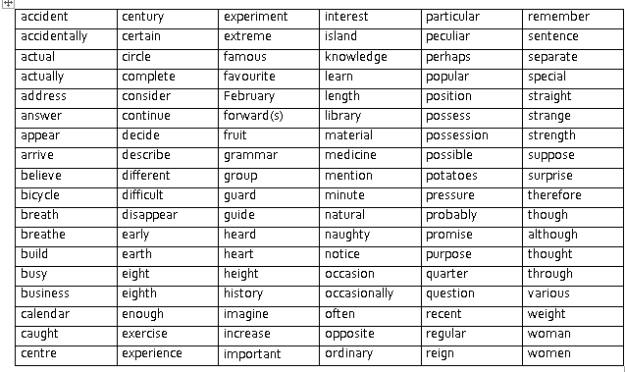
SPaG
Significant emphasis on spelling & grammar
Expectation to use correct punctuation and grammar in all writing.
Weekly spelling rules to practise linked to class work
Statutory spelling list for Years 3 and 4

Slide 14
Reading
We want to foster a love of reading – reading for pleasure is the aim of the game
Read a wide range of fiction, non-fiction, magazines, newspapers, e-books!
Independence - but still supported – PLEASE sign reading record on a regular basis
Aiming for at least book a week, ask questions, discuss opinions etc through VIPERS. Books changed on Mondays only so please encourage re-reading and supplementing with books from home/library

Slide 15
Homework
Spellings
Times tables book (KS 2 only)

Slide 16
Useful information
Email address: admin@ovinghamfirst.northumberland.sch.uk
Website: http://www.ovinghamfirst.northumberland.sch.uk
Twitter: OvinghamCEFirst

